Slide 1
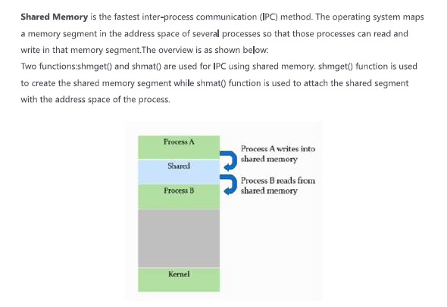

Slide 2
Shared Memory
Creating a Shared Memory Segment
  Allocated in byte amounts
Shared Memory Operations
  Create
  Attach
  Detach
Shared Memory Control
  Remove

Slide 3
shmget System Call
Function
The shmget system call is used to create or access a shared memory segment.
Include: <sys/types.h> <sys/ipc.h> <sys/shm.h>
Command: int shmget (key_t key, int size, int shmflg);
Returns: Success: unique shared memory identifier.
Failure: -1 ; Sets errno: Yes.
Arguments:
  key_t key: key for creating or accessing shared memory
  int size: size in bytes of shared memory segment to create. Use 0 for accessing an existing segment.
  int shmflg: segment creation condition and access permission.

Slide 4
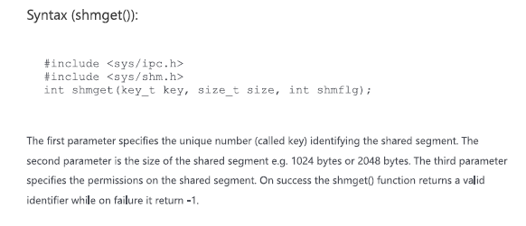

Slide 5
Shared Memory Limits
Shared Memory Segment Defaults Value
Maximum segment size 1,048,576 bytes
Minimum segment size 1 byte
System wide maximum number of segments 100
Maximum number of segments per process 6?
that can be attached

Slide 6
shmat System Call
Function:
used to attach (map) the referenced shared memory segment into the calling process’s data segment. The pointer returned is to the first byte of the segment
Include: <sys/types.h> <sys/ipc.h> <sys/shm.h>
Command: void *shmat ( int shmid, void *shmaddr, int shmflg);
Returns:
  Success:Reference to the data segment address of shared memory;
  Failure:-1; Sets errno:Yes.
Arguments:
  int shmid: a valid shared memory identifier.
  void *shmaddr: allows the calling process some flexibility in assigning the location of the shared memory.
  int shmflg: access permissions and attachment conditions.

Slide 7
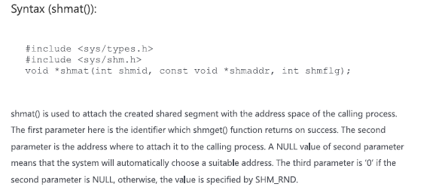

Slide 8
shmdt System Call
Function
shmdt is used to detach the calling process’s data segment from the shared memory segment.
Include: <sys/types.h> <sys/ipc.h> < sys/shm.h>
Command: int shmdt (void * shmaddr);
Returns: Success: 0; Failure: -1; Sets errno: Yes.
Argument:
  void *shmaddr: a reference to an attached memory segment (the shared memory pointer).

Slide 9
shmctl call - Shared Memory Control
Function: shmctl permits the user to perform a number of generalized control operations on an existing shared memory segment and on the system shared memory data structure.
Include: <sys/types.h> <sys/ipc.h> <sys/shm.h>
Command:
int shmctl(int shmid, int cmd, struct shmid_ds * buf);
Return: Success: 0; Failure: -1; Sets errno: Yes.
Arguments
  int shmid: a valid shared memory segment identifier.
  int cmd: the operation shmctl is t perform.
  struct shmid_ds * buf: a reference to the shmid_ds structure

Slide 10
When Linux file permissions are represented by numbers, it's called numeric mode. In numeric mode, a three-digit value represents specific file permissions (for example, 744.) These are called octal values. The first digit is for owner permissions, the second digit is for group permissions, and the third is for other users. Each permission has a numeric value assigned to it:
r (read): 4
w (write): 2
x (execute): 1
In the permission value 744, the first digit corresponds to the user, the second digit to the group, and the third digit to others. By adding up the value of each user classification, you can find the file permissions.
For example, a file might have read, write, and execute permissions for its owner, and only read permission for all other users. That looks like this:
Owner: rwx = 4+2+1 = 7
Group: r-- = 4+0+0 = 4
Others: r-- = 4+0+0 = 4
The results produce the three-digit value 744.

Slide 11
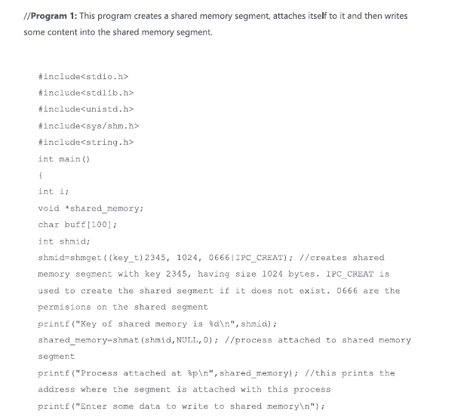

Slide 12
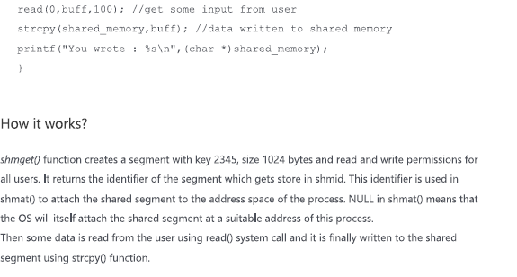

Slide 13
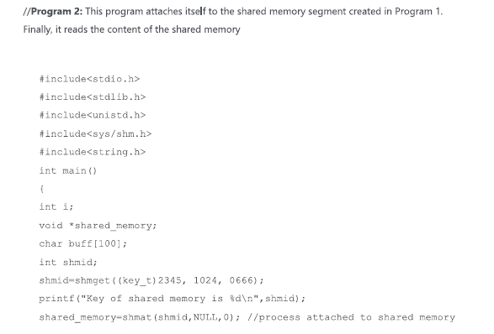

Slide 14
